Slide 1

SEARCHING

Slide 2
SESSION OVERVIEW:
DEFINITION
An Algorithm Used to Find the elements in the List
TYPES
Linear Search
Binary Search

Slide 3
LINEAR SEARCH
Start from the leftmost element of list[] and one by one compare x with each element of list[]
If x matches with an element, return the index.
If x doesn’t match with any of elements, return -1.

Slide 4
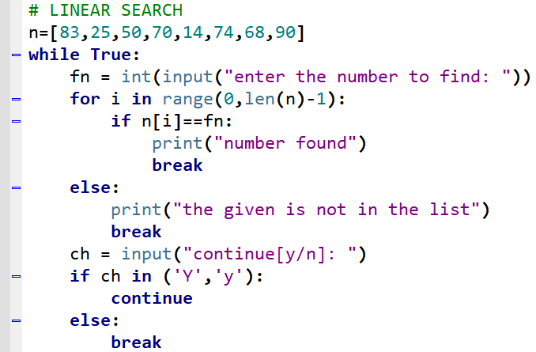


Slide 5
BINARY SEARCH
Search a sorted array by repeatedly dividing the search interval in half.
We basically ignore half of the elements just after one comparison.
Compare x with the middle element.
If x matches with middle element, we return the mid index.
Else If x is greater than the mid element, then x can only lie in right half subarray after the mid element. So we recur for right half.
Else (x is smaller) recur for the left half.

Slide 6
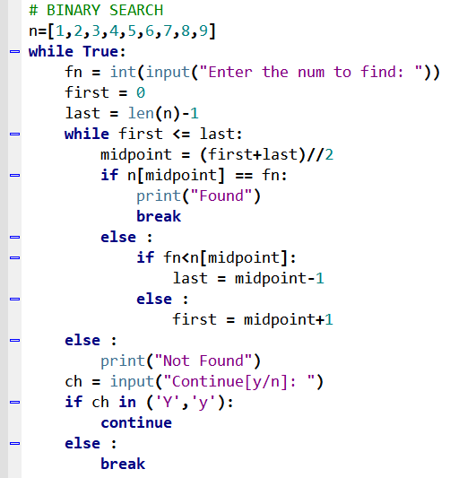
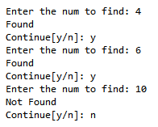

Slide 7

CODING IS FUN ! THANK YOU !!

